Slide 1
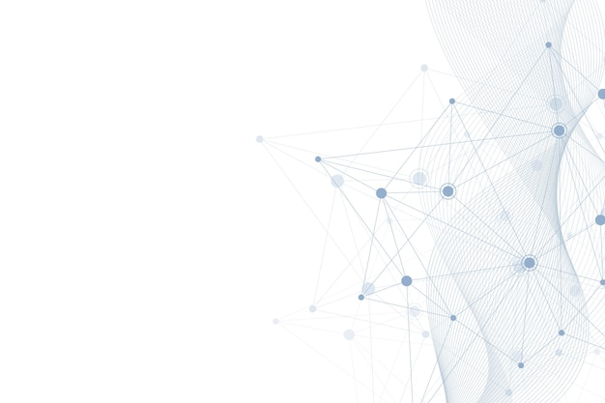
Networking
A Level Digital Technology | Mr Butler

Slide 2
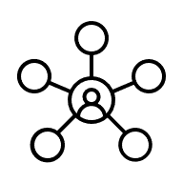
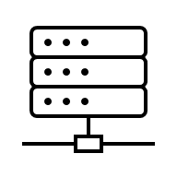

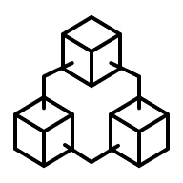



What we need to know
Describe networks by their scope: local area network (LAN), metropolitan area network (MAN) and wide area network (WAN)
Describe the purpose of the network resources: network card, server, switched hub, repeater, wireless access point, media converter, IP address and media access control (MAC) address
Define the purpose of an IP address and a MAC address
Describe the features of a peer-to-peer (P2P) and server-based networks
Evaluate the bus, star and ring network topologies

Slide 3

What is a Network?
A network is a linked set of computer systems, which may be capable of sharing computer power and resources such as printers, file storage and databases.
Sometimes the term network is used to mean the arrangement of links between the equipment that form the network.
These links can be connected together via cable or wireless technology.
Definition Of a Network

Slide 4



What is a Network?
Networks can be classified as a LAN (Local Area Network), a WAN (Wide Area Network) or a MAN (Metropolitan Area Network).
A LAN is spread over a small geographical area such as a building or an office
a metropolitan area network (MAN) is a network that interconnects computers in a geographic area larger than that covered by a large local area network (LAN) but smaller than the area covered by a wide area network (WAN) for example in one city.
A WAN is spread over a vast geographical area on a global scale. Therefore, a WAN requires a telecommunications link such as a fibre optic cable or a satellite, to allow computers on the network to communicate.
LAN
MAN
WAN
Describing Networks by their scope

Slide 5
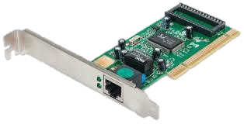
Network Cards
It connects a computer to a LAN so that it can communicate with the file server. It provides a port for connecting a network cable/Ethernet cable. This allows the exchange of data with the network.
Each computer on the network must have its own dedicated network card so that it can communicate with the file server and the other computers on the network. The network card also provides a ‘port’ on the computer to allow a network cable (such as Ethernet) to be attached to the network interface card.
Portable computers such as laptops are supplied with a standard Wireless Network Interface Card (WNIC) provided by the manufacturer
The Purpose of Network Resources

Slide 6
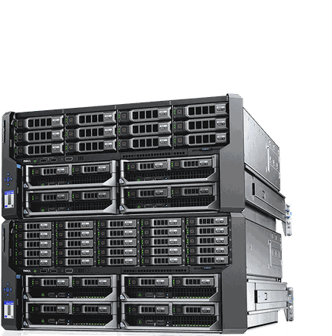
Server
A server is a computer on the network that provides a resource that can be used by any authorised client station. There are different types of server, including file servers, web servers and database servers to name a few.
A server is the computer on a network that manages resources. There are many different types of servers used on a network. A File server is a computer and storage device dedicated to storing user files whereas a Print server is a computer that manages one or more printers. Therefore, Servers tend to be dedicated as they only perform their server tasks.
Further Server types can be found on page 138 of the BCS Glossary
The Purpose of Network Resources

Slide 7
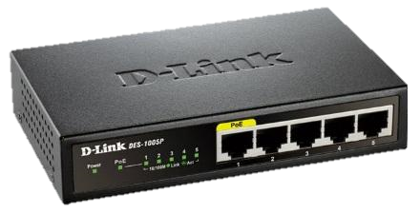
Switched Hub
Acts as a connection point for a number of network computers (nodes). It checks the destination (IP Address) of data packets it receives and forwards them to the intended recipient using the optimum route.
Switched hubs act as hubs but have extra circuitry, ‘switching circuitry’, which allows them to deal with many connections simultaneously. They are much more efficient than simple hubs. A Hub is the central node of the network, i.e. a computer that has separate connections to each computer or terminal.
This is a hardware device and it is a single connection point for computers on a network. The switch allows a large number of computers to be connected to it directly using network cables. Its purpose is to check the destination of data it receives and ensures it is forwarded to the intended computer.
TASK: Look at https://www.educba.com/hub-vs-switch/ and create a table showing the comparisons between a switch and a hub.
The Purpose of Network Resources

Slide 8
Switch Vs. Hub
Hub | Switch
A hub is also known as a repeater that transmits the amplified signal to every port except the port from where the signal was received | A switch is a device to set up and terminate the connections according to requirements in a broad sense
Works in Physical layer | Works in data link layer
Can be linked via central hub to link a network of personal computers together | Allows multiple system connections and manages ports
Transmission data is in the form of individual bits (electrical signals) | Transmission data is in the form of a packet
Transmission speed is limited to 10 Mbps | Transmission speed is between 10 Mbps – 1Gbps
Electronic device connecting other network devices to allow them to exchange information. | A network switch is a computer network device used on a computer network to connect many devices together. A switch is considered to be more progressive than a hub since a switch sends a message to a device it needs or requests.
The Purpose of Network Resources

Slide 9
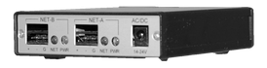
Repeater
Used to link two cable segments, a repeater amplifies the signals it receives before passing them on. This is because of the loss of signal strength of network cables.
These are used when a signal gets distorted due to the loss of transmission over longer distances.
It regenerates the signals, reconstructing the data received to its original quality resulting in no data loss.
The Purpose of Network Resources

Slide 10


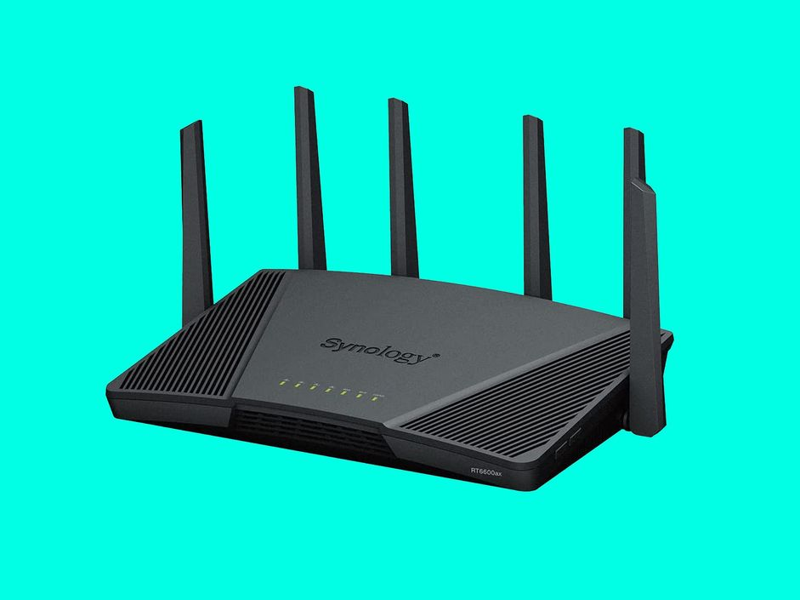
Wireless Access Point (WAP)
A WAP is a hub on the local network, which is used to connect a computer to a network/router using Wi-Fi or Bluetooth technology. It uses a hotspot, whereby when a device is in range it can use radio transmitters and antennae to communicate with the device by radio transmitters to the wireless access point
Any computer with a wireless network interface, which is within range, can connect to the network via this short distance radio frequencies.
The WAP normally make a connection to a router to access a network
Wi-Fi hotspots commonly use a wireless access point to support their Wi-Fi coverage area
The Purpose of Network Resources

Slide 11
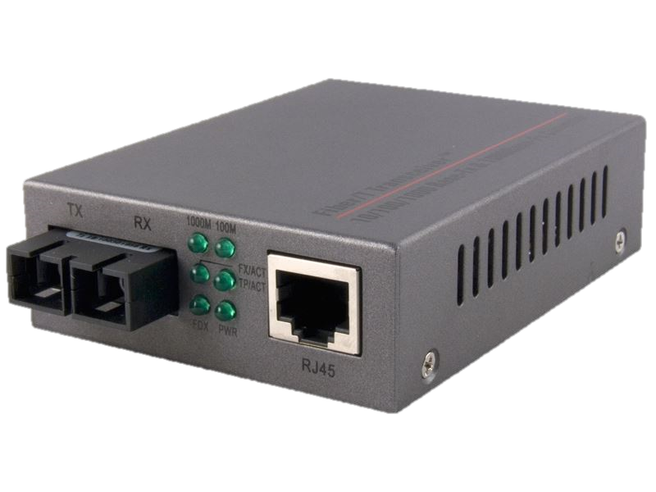
Media Converter
Allows two dissimilar media types to connect together. It achieves this by changing the physical signal from one media type to another such as fibre optic cable and copper
Media converters are often used in pairs to insert a fibre segment into copper networks to increase cabling distances and enhance immunity to electromagnetic interference.
They can also extend LANs, and convert link speeds and fibre modes.
The Purpose of Network Resources

Slide 12
IP Address Vs. MAC Address
An IP Address is a unique address used to identify a device on a network. This allows information to be sent between devices on the network. It can be set as static or dynamic, and can be changed.
A MAC (Media Access Control) Address is used to identify a computer’s network interface card on a LAN. It again is a unique address which is allocated to the card when manufactured.
Networks using the TCP/IP protocol route messages using the IP address of the destination.
An IP address consists of 32 bits formatted as 4 octets of numbers ranging from 0-255 in decimal form. For example, an IP address of a device could be 134.213.246.167
Due to the vast quantity of network cards manufactured there has to be a wide range of possible MAC addresses. They are made up of six two-digit hexadecimal numbers, separated by colons. For example, a network card may have a MAC address of 0a:1d:8f:b1:c0:8e.
The Purpose of IP Addresses and MAC Addresses

Slide 13

IP Address’
IP is short for Internet Protocol.
A 'protocol' is a set of rules for doing something. In this case it is the task of being able to uniquely identify every computer connected to an IP based network. It is a standard set of rules used to ensure the proper transmission of information between computers on the internet. It defines how data is to be structured, and what control signals are to be used.
The way this is done is to assign a long number to each computer made up of 4 bytes. This normally takes the form of four, three-digit numbers separated by a dot. Like this 255.168.101.004
  Of course, behind the scene this is actually a 32-bit binary number (4 bytes). Each number group in the address sub-divides the network to which the computer is connected with the final number (004 above) being the actual computer. The Internet is a vast collection of smaller networks each connected to one another through routers.
Interesting fact
The internet is running out of addresses. The current scheme was designed to handle up to 4 billion addresses and everyone thought this would be enough. But with mobiles, gaming machines and even fridges getting connected to the internet this will soon become a problem.
A new protocol called IPv6 has been developed, this uses 128 bits for each address rather than 32. This offers a range of 3 followed by 38 zeros unique addresses. Enough to address every grain of sand on Earth - it should be enough!
The Purpose of IP Addresses and MAC Addresses

Slide 14
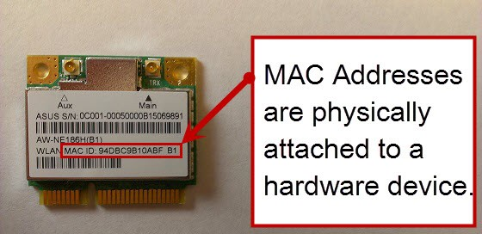
MAC Address’
Short for Media Access Control address.
This is the unique identifier assigned to a network card or Wi-Fi adapter.
  The code identifies the card and also the maker of that card.
  It is a 48-bit binary number stored within the card hardware itself.
To make it a bit more people friendly the MAC address is usually quoted as a set of six hex number like this: MAC address: 0A-14-FF-32-11-23
If you set up a Wi-Fi one of the things you can do to improve security is to only allow devices with certain MAC addresses to connect to the network.
The Purpose of IP Addresses and MAC Addresses

Slide 15
Peer To Peer Networks
This is a simple network that provides shared resources, such as printers and storage, but may offer little else in the way of additional features, such as file security.
The name comes from the fact that all of the computers on these networks have equal status, and can send data to and from each other.
  For example, one station may send data to another station, which can then print it out, acting as a print server.
  Similarly, one station can send data to another for storage on that station’s disk drive.
Each computer on the network is defined as both a supplier and a consumer of resources. Computers make some of their resources such as processing power and disk storage available to other computer and in turn they can request a resource from another computer. Each node is in charge of its own security and administration and decides which other nodes gets access to its resources.
There is no dedicated or central server on a peer to peer network, as all computers have equal status. Each computer or node on the network is both a supplier and a consumer of resources. Each computer controls how its resources are shared and is in charge of its own security.
Peer To Peer And Server Based Networks

Slide 16
Client-Server Networks
A client server network is organised around one (or more) servers. The server maintains a database of authorised users, passwords and access rights. Usually (but not always) a server also acts as a file server, but its prime function is to provide the security for the network.
One or more dedicated computers (servers) provide resources for clients. The server manages the resources and security. There are multiple client terminals which request resources off the server. In short, one computer acts as file server, providing resources for all other dumb terminals.
The 'client' part of the network are the workstations that people log onto to use the network facilities.
When the user is connected to the server they will have access to a number of resources such as:
  a dedicated area to store their data,
  hardware resources such as printers,
  application software.
Reliance on one central computer can cause problems to the organisation particularly when it crashes.
Peer To Peer And Server Based Networks

Slide 17
Comparison Of Client-Server and P2P
Client-Server | Peer-Peer
Complex to set up | Simple to set up
Requires technical expertise to set up and maintain | Needs basic technical skills
Server present | No server present, each computer is a 'peer' of the others
Centralised data and application management | Each computer has its own data and applications loaded
Uses a dedicated network operating system | Uses standard operating system with network capabilities
Security is managed centrally, and server can be in a locked room | Only as secure as the most vulnerable computer in the network e.g. a wireless laptop is not physically secure
User access and authentication is managed centrally | Fairly basic login authentication for each user
Peripherals are managed centrally and available to client computers | Peripherals can be shared but the computer it is attached to must be powered on as well
Users can roam from machine to machine and still have access to their applications, data and desktop setup | User data is one of the networked machines which must be on for access. User data must be in a 'share' folder if it is to be visible on the other machines
Peer To Peer And Server Based Networks

Slide 18
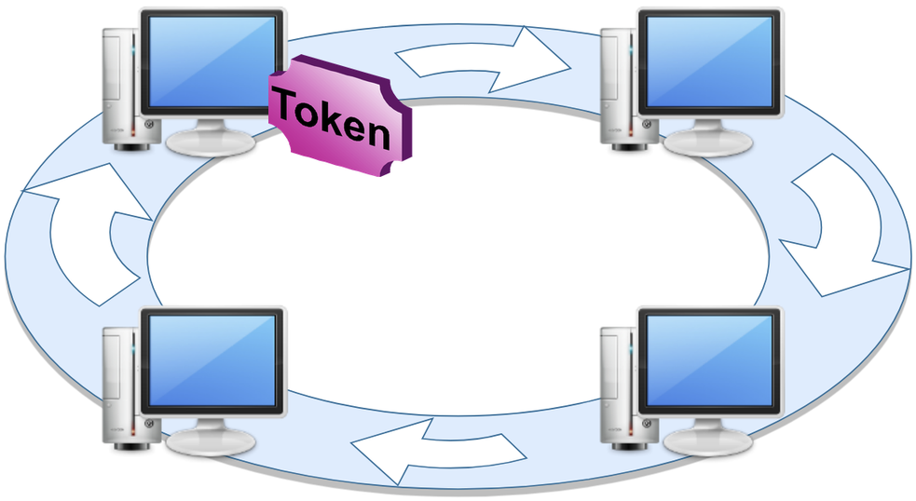
Ring Topology
The network consists of a number of nodes connected together without the need for a fileserver. Each node is connected to two other adjacent nodes.
A special message called a token is passed from node to node.
    While a node has possession of the token it can add a message data to the network.
    This is passed from node to node until it arrives at its destination.
All data travels in one direction only therefore avoiding any potential collisions.
It is difficult adding new nodes to this network.
    To add a new node to the network an existing cable has to be severed and join to either end of the new node.
A broken connection in the main cable will also cause the network to fail but in some cases it is possible to isolate a faulty node.
If data travels large distances around the cable this can lead to problems with the data signal; it tends to degenerate and weaken.
  To overcome this, repeaters are used which are known as special boosters
Ring, Star and Bus Topologies

Slide 19
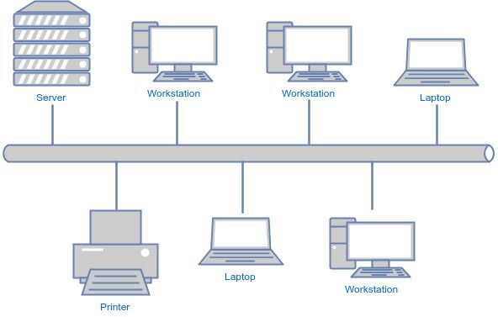
Bus Topology
In this network all nodes are connected onto the main cable (known as the backbone). Data can be transmitted in both directions on the main cable.
  At both ends of the main cable terminators are used.
  Every node can transfer data directly to any other node by sending it onto the main cable.
If one of the nodes is not functioning correctly the network can still operate
it is easier to add new nodes on this network compared to other topologies such as ring.
The downside is the more nodes added to the backbone the slower the transmission speeds due to increase volumes of traffic.
Problems arise when more than one node wishes to send a message at the same time. This can lead to collisions. To avoid collisions a protocol known as CSMA/CD is used on a bus network.
This involves each node checking whether or not the main cable is busy. If the main cable is busy then the terminal will wait. If a collision occurs the node will re-transmit the same message at a later time.
Ring, Star and Bus Topologies

Slide 20
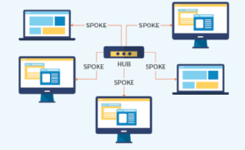
Star Topology
In this type of network there is central fileserver (host computer) whereby each node is connected to the fileserver by its own cable.
The host computer controls all communication on the network such that if a node wishes to communicate with another node this must be done via the fileserver. If the fileserver malfunctions, then the whole network fails.
Using a star network has advantages. Each node has its own connection to the hub there is no contention for pathways.
Also, if a node fails then the network can still operate as it only affects that node.
Adding a new node is only a matter of connecting it to the hub if there is capacity.
Ring, Star and Bus Topologies

